Slide 1
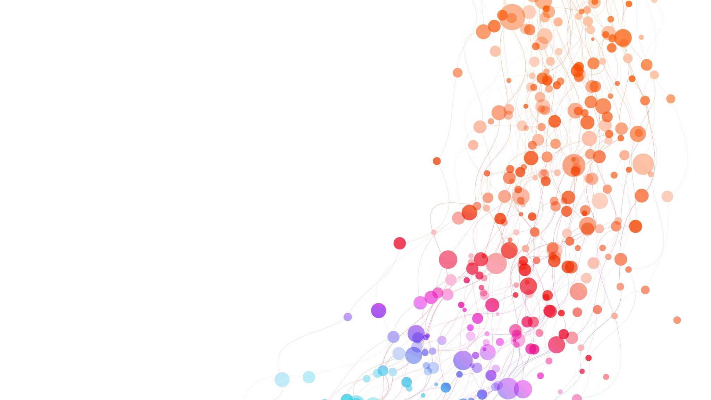
Basic Introduction to Safeguarding
By Simon Sykes

Slide 2
Introduction
Thank you for attending this short course on Safeguarding. This module will explore safeguarding issues, the signs and types of abuse, as well as online safety issues and an overview of the referral process.
This course has been put together by the WRU safeguarding officer to help with basic training of all church members so they can better understand their roles and responsibilities.
We hope you will find it helpful.

Slide 3
Children and Vulnerable Adults
While this presentation focuses mainly on safeguarding children it is important to remember that many types of abuse can happen to people of any age and there are many vulnerable adults that will also need our help and support.
In taking this course you are taking steps towards creating a safer environment for children and vulnerable adults and improving your own knowledge.
This course provides an introduction to safeguarding. You will gain a basic understanding of what safeguarding is and why it is so important.

Slide 4
Learn at your pace!
During this presentation we will be looking at topics that some people may find difficult or distressing. If you feel the need to stop and have a break or you need to step out of the room for a minute that is fine.

Slide 5
Course Aims and Objectives
This module will look at
Defining Safeguarding and why it is important
Main types of abuse
Other forms of abuse
Your roles and responsibilities
What to do if you are worried

Slide 6
Defining Safeguarding Which of the following statements are relevant to safeguarding
1
Protecting Children from Harm
Preventing neglect, abuse and exploitation
3
Taking action to enable all children to have the best outcome
4
Helping children to reach their potential
5
Providing a safe environment
6
Helping children and vulnerable adults to get the most out of life
7
Providing help and support to meet needs as soon as problems emerge
2

Slide 7
All of them

Slide 8
Why is Safeguarding important and why is it my responsibility
Anyone who works with children or vulnerable adults need to make sure that they help to keep them safe.
As well as being a legal requirement we also have a biblical obligation as Christians to ensure that these people are safe in our care.

Slide 9
Speak up for those who cannot speak for themselves, for the rights of all who are vulnerable.
Proverbs ch 31 v 8

Slide 10
Working Together to Safeguard Children 2023
This is the governments guide for all agencies and organisations who are working to safeguard and promote the welfare of children and can be found online if you need to refer to it.
Working Together to Safeguard Children 2023 (publishing.service.gov.uk)

Slide 11
Coordinated Help
Individual children, especially some of the most vulnerable children and those at greater risk of suffering harm and social exclusion, need coordinated help from health, education, early years, children’s social care, the voluntary sector and other agencies such as the church and other community groups.

Slide 12
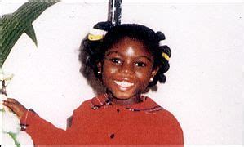
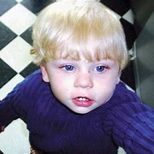
Serious Case Reviews If a child dies or is seriously injured due to suspected abuse or neglect, a review is carried out to establish the lessons that can be learned to prevent similar incidents from happening again in the future
Victoria Climbie
The death of Victoria Climbie (Feb 2000) highlighted serious failings in the child protection system and led to new legislation and guidance.
Peter Connelly
On 3rd August 2007 Peter was found dead in his cot 48 hours after a doctor had failed to spot the child’s severe injuries, including a broken spine.
The toddler was on the Council’s child protection register throughout the 8 months in which he suffered more than 50 injuries.
His family had been seen 60 times by different agencies but no one had spotted the signs.

Slide 13
Child Abuse
Child abuse is any action by another person – adult or child – that causes significant harm to a child.
Some can be physically abused and faced with violence on a daily basis.
Others are sexually and emotionally abused, but can also be about lack of care, love and attention.
Neglect can be just as damaging to a child as physical abuse.
However, abuse is more likely to be found in combination than on its own.

Slide 14
Types of Abuse
Physical Abuse
Neglect
Emotional Abuse
Sexual Abuse
Domestic Abuse
Online Abuse
Bullying and Cyberbullying
Child Trafficking
Grooming
Harmful Sexual Behaviour
Child exploitation
Spiritual Abuse
Female Genital Mutilation (FGM)
Infant Oral Mutilation (IOM)

Slide 15
Physical Abuse

Slide 16
Physical Abuse
Physical abuse is the deliberate hurting of a child or vulnerable adult by another person or persons, causing injuries such as bruises, broken bones, cuts or burns.

Slide 17
Possible signs of Physical Abuse
Injuries not consistent with the explanation given for them.
Injuries that occur in places that are not usually exposed to falls or rough games or injuries that do not receive appropriate medical attention.
Bruises, bites, burns and fractures which do not have an accidental explanation.
The child gives inconsistent accounts of the cause of the injuries.
A reluctance to get changed for activities such as PE or swimm
Any bruising on a non mobile baby

Slide 18
Sexual Abuse

Slide 19
Sexual Abuse
A child is sexually abused when they are forced or persuaded to take part in sexual activities. This does not have to be physical contact and it can happen online. For example, children being made to watch pornographic images.
Sexual abuse could include:-
Physical contact, Kissing, Rubbing, Touching, Assault by penetration or non penetrative acts
Sexual Abuse is usually committed by someone who is close to the child, i.e. a family member or a close friend.

Slide 20
Possible signs of Sexual Abuse
Child has excessive knowledge or sexual behaviour inappropriate for their age.
Repeated urinary infections or unexplained stomach pains.
The child is sexually provocative or seductive with adults.
Severe sleep disturbances with fears, phobias or dreams that have a veiled sexual connotation.
Eating disorders such as anorexia or bulimia.

Slide 21
Emotional Abuse

Slide 22
Emotional Abuse
Children and vulnerable adults who are emotionally abused suffer maltreatment or neglect. It is sometimes called psychological abuse and can cause serious harm to the individual.

Slide 23
Emotional Abuse could involve :-
Making someone feel worthless or unloved
Mocking a child
Shouting at or swearing at a child
Bullying
Preventing normal social interactions
Stopping a child from learning
Consistently scaring a child
Exploiting or Corrupting a child

Slide 24
Possible signs of Emotional Abuse
Depression, aggression, extreme anxiety or changes to mood or behaviour particularly where a child withdraws or becomes clingy.
Obsessions or phobias.
Always seeking adult attention and not mixing well with other children.
Negative statements about self
Sleep or speech disorders.
Running away, stealing or lying.

Slide 25
Neglect

Slide 26
Neglect
Neglect is the ongoing failure to meet a child’s basic needs, health, food, shelter and relationship. It is dangerous and children can suffer long-term harm.
Neglect could also involve substance abuse during pregnancy.

Slide 27
Neglect could include failure to provide :-
Necessary food and drink
Access to good personal hygiene
Adequate Clothing
Clean and safe shelter
Warmth
Love
Protection
Supervision
Access to medical or dental care

Slide 28
Signs of possible Neglect
Child may look dirty and unwashed
Clothing may look dirty, too big or small or inappropriate for weather conditions.
Frequently left unsupervised.
Frequently hungry or tired.
Untreated illnesses, infected cuts or physical complaints that the carer does not respond to.

Slide 29
Domestic Abuse

Slide 30
Domestic Abuse
All couples can fall out from time to time but when that escalates into something more, it can affect the whole family. Children witnessing domestic abuse is a form of child abuse and teenagers can also suffer domestic abuse in their personal relationships.

Slide 31
Signs of possible Domestic Abuse
Children may become anxious or depressed.
They may have difficulty sleeping
They may become aggressive towards others.
Or they may become withdrawn from other people.
They may keep complaining of physical symptoms such as tummy aches.
They may have a lowered sense of self-worth.
Older children may begin to truant or begin to self harm.

Slide 32
Bullying and Cyberbullying
Bullying can happen anywhere – at school, at home or online (cyberbullying).
It is usually something that is repeated over a long period of time and can have both physical and emotional effects on the individual.
Bullying can be adult on adult, adult on child, child on child or even child on adult.

Slide 33
Spiritual Abuse

Slide 34
Spiritual Abuse
Spiritual abuse is when someone uses religious or spiritual beliefs to control, manipulate, domineer, bully or hurt another person as a means of maintaining his own power and control. It can take place in a personal relationship or within a spiritual organization.
Spiritual abuse can happen in any religious group and can be part of domestic violence, child abuse or elder abuse. The victim of spiritual abuse may not be aware that they are being abused.

Slide 35
Examples of Spiritual Abuse include :-
Forcing someone to participate in religious practices they don’t want to
01
Preventing someone from practicing their religious beliefs
02
Using religious teachings to force someone to stay in a relationship or marriage
03
Using religious teachings to excuse or blame someone for violence or abuse
04
Using religious teachings to pressure someone into a marriage they don’t want
05

Slide 36
Grooming
Children and young people can be groomed online or in the real world, by a stranger or someone they know – a family member, friend or professional.
Grooming is building a relationship, trust and emotional connection with someone so they can manipulate, exploit and abuse them.

Slide 37
Harmful Sexual Behaviour
Harmful Sexual Behaviour (HSB) is developmentally inappropriate sexual behaviour displayed by children and young people which is harmful or abusive.
Peer on peer sexual abuse is a form of HSB where sexual abuse takes place between children of a similar age or stage of development

Slide 38
Child Trafficking

Slide 39
Child Trafficking
Child trafficking is a crime involving the movement of children who are then exploited, forced to work or sold.
Children are trafficked for:-
Child sexual exploitation
Domestic servitude such as cleaning, childcare or cooking
Benefit fraud
Forced marriage
Forced labour
Criminal activity such as pickpocketing, begging, drug transporting and bag theft

Slide 40
Signs that a child may be a victim of trafficking
Signs may Include :-
Appear generally, physically and emotionally neglected.
Move location frequently
Are not registered with a GP, Nursery or School.
Look malnourished.
Have old or serious untreated injuries
Have vague or inconsistent explanation of where they live.
May appear very withdrawn.
Appear unrelated to those presenting as their parents / carers.
Have strange interactions with people they are with – watch for non-verbal communication and body language.

Slide 41
What to do if you suspect a child is a victim of trafficking?

Slide 42
Always maintain a child-centred approach.
Make a note of everything you hear between the child and the adult with them.
Contact the police as a matter of urgency.

Slide 43
True or False
Children are only trafficked into the UK from abroad.

Slide 44
False!
Many children are trafficked into the UK from abroad, but children can also be trafficked from one part of the UK to another.

Slide 45
Fabricated or Induced Illness (FII)

Slide 46
Fabricated or Induced Illness
Fabricated or induced illness is a rare form of child abuse.
This used to be called Munchausen’s syndrome by proxy. It occurs when someone who is caring for a child fakes or causes symptoms of illness in the child.
In 90% of cases, the perpetrator has been found to be the child’s biological mother.
If you are concerned about a child being at risk from FII, then you must urgently seek support and advice from children’s social care.

Slide 47
Female Genital Mutilation (FGM)

Slide 48
Female Genital Mutilation (FGM)
Female Genital Mutilation (FGM) is the partial or total removal of external female genitalia for non-medical reasons.
This practice has no health benefits and can cause many problems for the child including complications and death during pregnancy and childbirth in later life.
FGM is opposed by the World Health Organisation but figures suggest up to 3 million girls are estimated to be at risk from FGM each year.

Slide 49
Where does FGM happen?
FGM is illegal in this country, although there are concerns that it is taking place in the UK.
It is also illegal to arrange to take a girl to another country for FGM, but girls are taken frequently out of the country to their countries of origin.
FGM is prevalent in many African countries and the middle east.

Slide 50
How many people does FGM affect?
It is estimated that over 20,000 girls and young women under the age of 15 are at risk from this hidden form of abuse in the UK every year.
It is carried out on girls of any age but most commonly before they reach puberty.

Slide 51
Why is FGM carried out?
FGM is prevalent in Africa and the Middle East. It is carried out for cultural, religious and social reasons in families and communities, typically by older women who are usually not medically trained.
This is an extremely traumatic form of abuse. Frequently girls are forcibly restrained and anaesthetics are not used.

Slide 52
Infant Oral Mutilation
Infant Oral Mutilation (IOM) is a dangerous and sometimes fatal traditional dental procedure performed in many areas of Africa, it is usually down to medical ignorance. Young children who are teething are often taken to a local healer when they are suffering from a fever or Diarrhoea and the soft white tooth buds which are just beginning to break through the gums are mistaken for parasitic worms.
Having diagnosed the tooth buds as worms the healer then proceeds to gouge them out usually using no aesthetic and unsterilised tools.

Slide 53
What should I do?
FGM and IOM can lead to many serious problems for the child including death.
If you believe a child has been or is at risk of being the victim of these types of procedures, you must contact the police or children’s social care immediately.

Slide 54
Radicalisation

Slide 55
Radicalisation can be described as the process by which people come to support terrorism and violent extremism, and in some cases, then join terrorist groups. In this section we will look at the following:-
What is radicalisation?
How can children and young people get exposed to messages of extremist groups?
What are the risks associated with radicalisation?
What are the indicators that a child is at risk?
What should I do if a child is at risk?

Slide 56
What is Radicalisation?
Radicalisation can be described as the process by which people come to support terrorism and violent extremism and, in some cases, then join gangs or terrorist groups.

Slide 57
How can children and young people get exposed to messages of extremist groups?
Through the influence of family members or friends.
Through direct contact with extremist groups and organisations.
Through the internet.

Slide 58
What are the risks associated with radicalisation?
Radicalisation can put a young person at risk of being drawn into criminal activity.
It has the potential to cause significant harm and is therefore a safeguarding matter.
Risks from radicalisation may be combined with other vulnerabilities, or may be the only risk identified.

Slide 59
What are the indicators that a child is at risk?
Use of inappropriate language.
Possession of violent extremist literature.
The expression of extremist views.
Advocating violent actions and means.
Association with known extremists.
Seeking to recruit others to an extremist ideology.
The expression of negative views of the police or authority.

Slide 60
What should I do if a child is at risk?
If you work with children or vulnerable adults, the Counter-terrorism and security act 2015 means you have a duty to have due regard to the need to prevent people from being drawn into terrorism.
The risk of radicalisation is the product of a number of factors. Identifying this risk requires that professionals exercise their professional judgement and seek advice, if necessary, from Children’s social care.

Slide 61
Internet and Virtual Dangers

Slide 62
Online Abuse
Online abuse is any abuse that happens on the web, whether through social networks, online gaming chat rooms or through a mobile phone.

Slide 63
Besides the tangible aspects of keeping children safe from harm, there are significant risks of sexual and emotional abuse for children via online and virtual environments.
Smartphones
Online games
Home computer
School computer
Chat rooms
Blogs
Social networking sites (Facebook, Snapchat, Whattsapp, Instagram etc)
Live streaming sites and apps such as Periscope

Slide 64
It is impossible to prevent children and young people from using the internet and technology.
Indeed, it can play an important role in children’s lives and help support their education and social life.
Research shows that almost all children have access to the internet, either at home or in school.
However, it is crucially important that children and young people know the risks and are able to protect themselves.

Slide 65
Child Sexual Exploitation (CSE)

Slide 66
What Is Child Sexual Exploitation?
Internet safety is very important when working with any child and their family.
Individuals may target and ‘Groom’ young people via social networking sites, with the view to sexually exploiting them.
For more information if you suspect this type of abuse please visit www.CEOP

Slide 67
CSE
Child sexual exploitation is a form of child sexual abuse.
It occurs where an individual or group takes advantage of an imbalance of power to coerce, manipulate or deceive a child or young person under the age of 18 into sexual activity in exchange for something the victim needs or wants, and/or for the financial advantage or increased status of the perpetrator or facilitator.
The victim may have been sexually exploited even if the sexual activity seems consensual. Child sexual exploitation does not always involve physical contact, it can also occur through the use of technology.

Slide 68
Please remember
This presentation is not an exhaustive list and no one sign or symptom means that abuse is definitely taking place, and it is important to see the big picture. Make sure that you do not jump to conclusions but at the same time if you have any concerns over the safety of a child speak with your church’s safeguarding officer. Only when we work together can we truly protect the children we come into contact with from abuse.

Slide 69
Keeping Children Safe
As an individual coming into contact or working with children, you are in a position of trust and responsibility.
What does this mean for you in your role?

Slide 70
Disclosure If a child makes a disclosure to you regarding any form of abuse it is important you are prepared
It is a big step for someone to disclose they are being abused.
A child may choose anybody to tell if they are being abused, and they will usually choose to speak to someone who they feel close to or makes them feel safe.

Slide 71
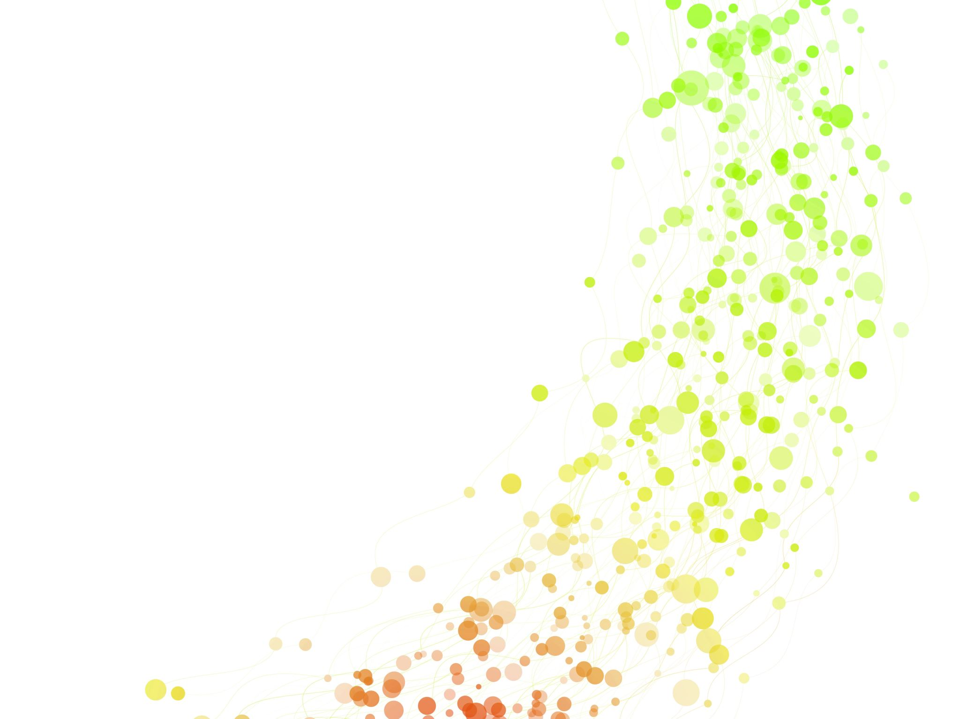
What should you do!
Listen carefully to what they are saying. (do not express your own views or look shocked)
Let them know they have done the right thing by telling someone.
Tell them it is not their fault.
Tell them you will take what they tell you seriously.
Don’t confront the alleged abuser.
Explain to the child what you have to do next. Tell them you cannot keep this secret and you will need to speak to someone who can help them.
Report what the child has told you as soon as possible to your safeguarding officer,
If the child is in immediate danger call 999.

Slide 72
Why children don’t tell
There are a number of common barriers that prevent children from talking about the abuse they are experiencing. And even if they do talk about their abuse, these same barriers can cause them to retract what they have said.
What sort of barriers do you think might prevent children from telling someone they are being abused?

Slide 73
The barriers could include:
They are scared
They believe they will be taken away from their home
They believe they are to blame, or they will break up their family
They may not realise what abuse is and think that this happens to all children
They may feel embarrassed or guilty
They may not want the abuser to get into trouble as they have a close relationship with them
They may have communication difficulties
They may not have the opportunity (for example if they are always with the person that is causing the harm)
They may not have a person they can trust to tell

Slide 74
Keeping children safe from harm.
Children need to feel secure and safe from harm to enable them to reach their full potential.
It is important that you consider how this can be achieved and maintained whilst they are in your care.
Know your safeguarding procedures. Everyone working with children should be familiar with their church’s policies and procedures for promoting and safeguarding the welfare of the children they come into contact with.
If you are unclear what the safeguarding policies are in your church you should speak to your safeguarding officer.
It is vital that you fully understand the safeguarding policies and procedures relating to your Church.

Slide 75
If in doubt -Ask!

Slide 76
What to do if you are worried about a child!
Keeping children and young people safe is everyone’s business.
If you have even the slightest concern about a child or young person’s welfare …..
DO NOT IGNORE IT – DO SOMETHING ABOUT IT!
Speak to your Church’s safeguarding officer or contact your local council Safeguarding Partnership or LADO (Local Area Designated Officer)
If the child is in immediate danger call the police on 999.

Slide 77
Thank you for your time, I hope you have found this training useful
Simon Sykes – WRU Safeguarding Officer
Si.jensykes@tiscali.co.uk
Tel :- 0775 4382470

